Slide 1

Higher Education contributing to EU Structural Funds Strategies
Sue Brownlow Director
Combined Universities in Cornwall
Berlin – November 2013

Slide 2
EU SIF in the UK
National approach – no regional (NUTS1) government
ERDF, ESF and EARFD programmes currently run by three separate Government departments
Department for Business, Innovation and Skills leading development of UK Partnership Agreement and England programme(s)
Separate chapters for devolved administrations (Scotland, Wales, Northern Ireland)
Local Enterprise Partnerships developing EU SIF strategies

Slide 3
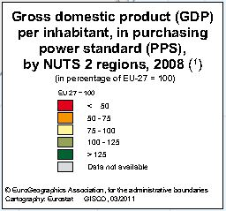
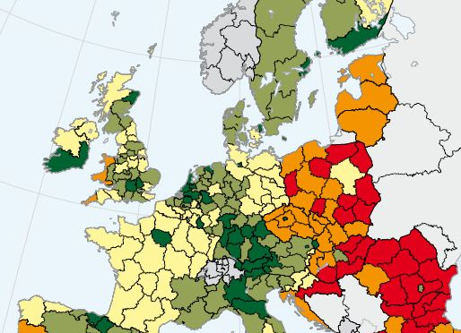
Gross domestic product (GDP)
per inhabitant, in purchasing
power standard (PPS),
by NUTS 2 region, 2008
(in percentage of EU-27 = 100)

Slide 4
Cornwall & Isles of Scilly– a less developed region
Population 534,500
GVA 7.5 bn in 2011
GVA growth 9.1% from 1999 – 2009
21,105 registered enterprises…
…of which 99.8% are SMEs
1 in 5 of the workforce is self-employed (cf 1 in 8 in UK)
Source: C&IoS EU SIF Strategy October 2013

Slide 5






About Combined Universities in Cornwall
Partnership of 5 main higher education providers
Supported by local authority and local enterprise partnership
Core purpose - develop higher education to support economic growth, raise aspiration and widen HE participation

Slide 6
Structural Funds investment in CUC
The journey:
Objective 1: developing HE infrastructure, taught programmes, encouraging graduate retention
ERDF examples
Tremough Campus
HE centre Truro College
HE centres Cornwall College
Knowledge Spa at Royal Cornwall Hospital
Agrifood innovation centre
ESF examples
Business short courses
Graduate Placements
Research Fund
Total Objective 1 investment (ERDF & ESF)
£147,000,000

Slide 7
Structural Funds investment in CUC
The journey:
Convergence – developing economically-relevant research, driving links with business, increasing higher level skills
ERDF examples
Environment and Sustainability Institute
PRIMaRE
Academy for Innovation and Research
European Centre for Environment & Human Health
Falmouth Marine School
Innovation centres and Innovation Vouchers
ESF examples
Enterprise Programme
Business short courses
Graduate Placements
Collaborative research (PhDs)
Raising Aspirations Programme
Total Convergence investment (ERDF & ESF)
£115,000,000

Slide 8
Sources of match funding
Central government capital allocation
Higher Education Funding Council
Regional Development Agency
Local Authority
Institutions’ own funds
Tuition fees, grants and loans
Business co-investment
Commercial venture-capital
Total funding package:
£180m ERDF and ESF
£135m match
Total investment £315m

Slide 9
CUC investment impact in Cornwall

Slide 10
Post 2013
EU SIF EUR 593,000,000 ERDF and ESF

Slide 11
Post 2013
CUC partners will:
Drive Smart Specialisation priorities in e-health, offshore renewables & marine engineering, agritech and digital creative industries

Slide 12
Post 2013
CUC partners will:
Develop business leadership, management & enterprise and vocational skills
Support innovative businesses to develop and grow
Build international links in key business sectors and technologies
Upskill individuals to progress in the labour market

Slide 13
Post 2013
CUC partners will:
Leverage financial investment in knowledge-based new business startup
Drive the growth of new business activity which exploits digital technologies
Educate business in how to shift to a low carbon economy
Take higher education into our deprived communities

Slide 14
EU Structural Funds financing for Scientific Institutions

Slide 15
EU Structural Funds financing for Scientific Institutions
Higher Education contributing to EU Structural Funds objectives

Slide 16





www.cuc.ac.uk

